Slide 1
session 7 – key points
relationships are central for health & wellbeing
funeral speeches – goals for relationship roles
robin dunbar’s research & personal social networks
how are we doing & s-dt needs for relatedness
emotional intelligence, closeness, the affect dyad

Slide 2
course outline/our journey
values, self-determination
mindset, exercise & sleep
willpower, diet, dependencies
mindbus & coping responses
savouring & gratitude
work, strengths, expertise
roles, dunbar, needs, dyads
nourishing, conflict, wisdom
groups, weak ties, resonance
review & stepping forward

Slide 3
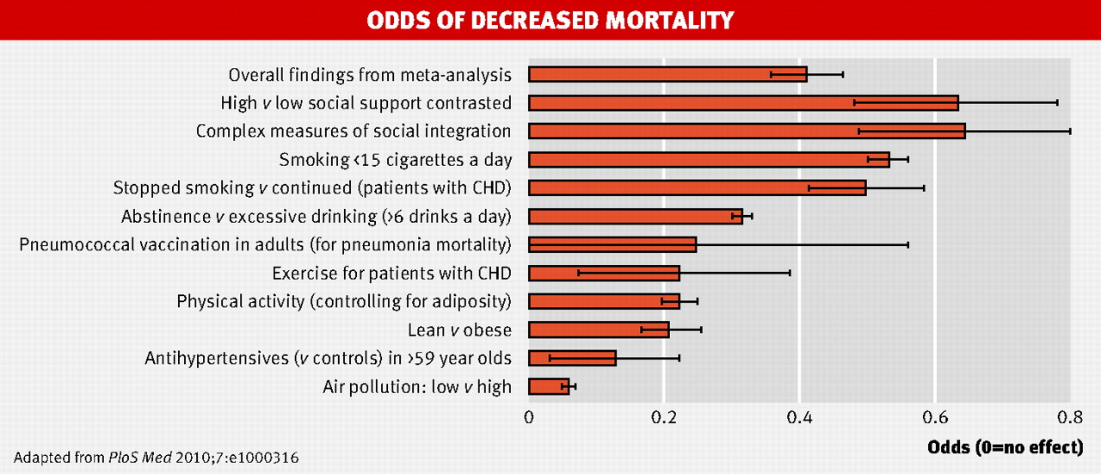
strong relationships improve survival as much as quitting smoking
.
Holt-Lunstad, J., et al. (2010). "Social relationships and mortality risk: a meta-analytic review.” PLoS Medicine 7(7): e1000316.
Chart taken from (2010) “Strong relationships improve survival as much as quitting smoking” BMJ 341: bmj.c4339

Slide 4
life satisfaction & relationships

Slide 5
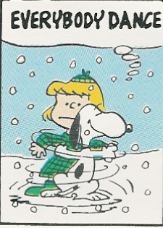
activity: how are we doing?
remembering the early exercise we did on ‘funeral speeches’, how are we doing in our key relationships roles?

Slide 6
personal social networks
Dunbar, R. (1998). "The social brain hypothesis." Evolutionary Anthropology 6(5): 178–190.
Stiller, J. & R. I. M. Dunbar (2007). "Perspective-taking and memory capacity predict social network size." Social Networks 29(1): 93-104.
Powell, J. L., et al. (2010). "Orbital prefrontal cortex volume correlates with social cognitive competence." Neuropsychologia 48: 3554-3562.
Dunbar, R. I. M. (2014). "The social brain: psych-ological underpinnings and implications for the structure of organizations." Current Directions in Psychological Science 23(2): 109-114.
Roberts, S. B. & R. I. Dunbar (2015). "Managing relationship decay: network, gender, and contextual effects." Human Nature 26: 426-450.
Mac Carron, P., et al. (2016). "Calling Dunbar's numbers." Social Networks 47: 151-155.
particular thanks for the extensive research on social networks conducted by Robin Dunbar, Oxford professor of evolutionary psychology, & colleagues

Slide 7
support clique/closest relationships
the ‘support clique’ are the people who one would turn to in times of extreme social, emotional or financial distress – note too ‘broaden & build’
on average there are about 5 people in the ‘support clique’ – with a range from 0 to 15 and sometimes 1 or 2 who are especially close - there may be a trade-off between overall numbers & individual closeness
these very close relationships involve considerable ongoing commitment of time, energy & emotion, but they ‘repay’ with major benefits for physical health, emotional resilience & overall wellbeing
‘support clique’ relationships are typically characterised by high emotional closeness, trust & frequency of contact
10 =
intensely close/intimate
fascinatingly ‘support clique’ numbers are limited not only by available time but also by ‘mentalising ability’ (perspective –taking competence) & the associated size of one’s orbital prefrontal cortex
0 =
emotionally neutral

Slide 8
sympathy group/good relationships
on average – including those in the ‘support clique’ - there are roughly 15 people in the ‘sympathy group’ – they are not so deeply close as those who are also in the ‘clique’ and are probably seen about monthly rather than approximately weekly for the ‘clique’
the ‘sympathy group’ are described as people who would be ‘devastated’ by the death of someone else in the group
typically there are about 3 x as many people in the ‘sympathy group’ as in the ‘support clique’ – and in both there are usually a considerably higher proportion of same sex contacts; people from large families may not have much time/space left in their sympathy group for non-family friends
emotional closeness changes & it takes time & regular contact to maintain – this is especially true for non-family friendships
10 =
intensely close/intimate
although both ‘sympathy group’ & ‘support clique’ numbers are limited by available time – the size of the latter is also dependent on mentalising ability (perspective –taking competence), while the former possibly depends more on memory capacity
0 =
emotionally neutral

Slide 9
activity: identifying relationships
who would you currently put into your inner circle ‘support clique’? note whether they are kin (k), kin by couple relationship (ck) or non-related friend (f); local (l) or non-local (nl); how long known; and how emotionally close (e?)
the ‘support clique’ tend to be who you would turn to in a crisis & also you value your regular (at least weekly?) contact with them. in contrast you have contact with the ‘sympathy group’ maybe only monthly & they are also less close

Slide 10
three (+one) key psychological needs
autonomy – personal choice not compulsion by outside forces
competence – capable & effective not incompetent & inefficient
relatedness – regular emotional intimacy & shared activities not isolation & loneliness
beneficence – benevolence, being able to give not just self-centred
autonomy
competence
relatedness
beneficence
Reis, H. T., K. M. Sheldon, et al. (2000). Daily well-being: the role of autonomy, competence, and relatedness. Pers Soc Psychol Bull 26(4): 419-435. Sheldon, K. M., A. J. Elliot, et al. (2001). What is satisfying about satisfying events? Testing 10 candidate psychological needs. J Pers Soc Psychol 80(2): 325-39.

Slide 11
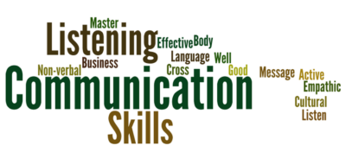
helpful communication central too
comfortable talking about my feelings
frequently encourage to express their views
always try to be honest
often ask for feedback
know how to describe my feelings accurately
praise & encourage far more often than criticize
try to make time for friendly conversation

Slide 12
meeting deeply
it’s likely to be most helpful if this communication is held in a setting of goodwill for oneself & for the other person
expressivity
receptivity
to deepen communication it can be useful to be aware of any blocks in the four phases highlighted in this diagram and fifthly to monitor the overall quality of goodwill
meeting
deeply
note too the possible
value of tracking five aspects of emotion – the trigger, body response, impulse, verbal label & associated wish or need
after Bugental,
Greenberg & Cooper
receptivity
expressivity

