Slide 1
what are values; why so important?
one's judgement of what is important in life
oxford
dictionary
principles or standards of behaviour
“only dead fish swim with the stream”
… and research study after research study shows that living to values/having purpose boosts energy and mood, strengthens resilience, reduces disease, and lengthens life

Slide 2
where do values come from?
evolutionary selection for linked individual and group fitness
evolving cultures & religious traditions are also major contributors
there’s a feedback loop involving values, thoughts & feelings, and behaviours
health & energy affect our viewpoint;
embodied cognition
genetic tendencies
behaviours
body condition
for example: posttraumatic stress & posttraumatic growth
life
events
parents
and family
individual
morality
current
values
attachment style
sibling interactions
parental modelling
life
situation
our characteristics colour the life situations we find ourselves in, but then the situations’ characteristics feed back to colour us
experiences growing up
relationships
emotions
experiences of success and of adversity are both important
‘birds of a feather’
morality – people’s ‘most important characteristic’
emotional states affect what we pay attention to & how we process information

Slide 3
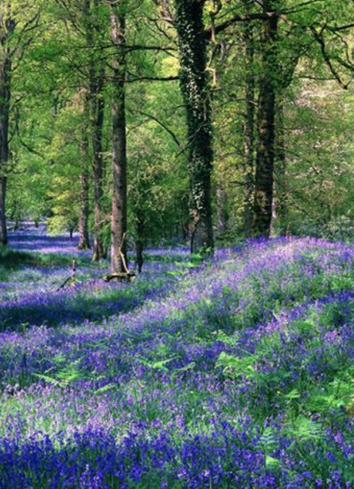
are some values ‘better’ than others?
individual
group
“The creature that wins against its environment, destroys itself”
Gregory Bateson
organization
town
country
are some values more ‘adaptive’ for individual, group & planet?
planet

Slide 4
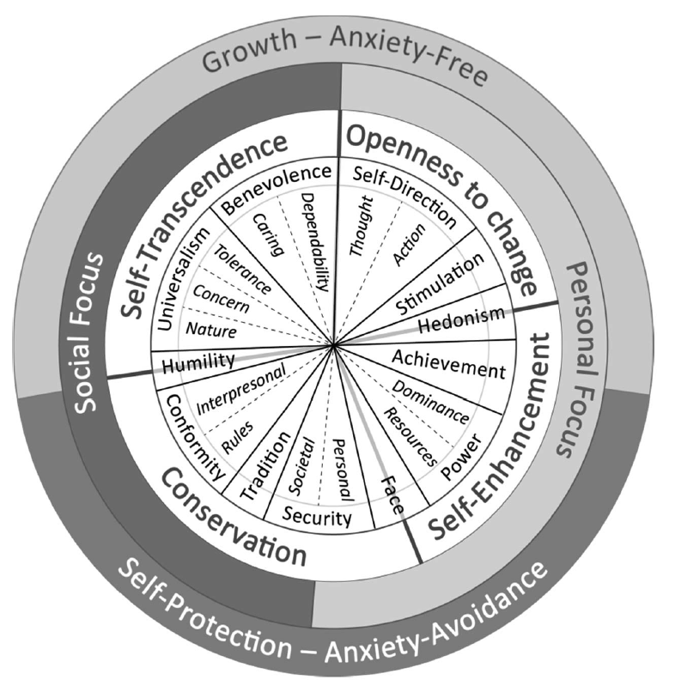
major reasons for hope
wonderfully in the over 80 countries that have been surveyed, easily the most endorsed values are benevolence, universalism & self-direction
As a ‘jump-off’ point, see Wikipedia’s two articles on Shalom H. Schwartz & the ‘Theory of Basic Human Values’

Slide 5
what can we do?
understanding what matters, choosing & cherishing our values
family, school
friends, groups
“A small group of thoughtful people could change the world. Indeed, it's the only thing that ever has”
Margaret Mead
working to change organizations, leadership
involvement in local campaigning/volunteering
activism & political engagement
“think globally act locally”
environmental & worldwide action

Slide 6
spine & heart: self-direction & kindness
high ‘agency’; self-direction
strength; competence
the ‘Big Two’:
agency & communion
Schwartz’s self-direction & benevolence/universalism
cooperation warmth; kindness compassion
competition coldness; hostility self-centeredness
S-DT’s autonomy, competence, relatedness & beneficence
(partially) attachment security, anxiety and avoidance
“There’s nothing so practical as a good theory”
Kurt Lewin
low ‘agency’; other-directed
weakness; incompetence

