Slide 1




key points of this talk
black heresy: what is therapeutic drift and does it really matter?
red herring: does it distract us from much more major problems?
four suggestions for ways out of therapy’s rather shocking impasse

Slide 2
reasons to be pleased
100’s of psychotherapy meta-analyses show effect sizes of approximately 0.6 (0.4 to 0.8)
in the social sciences, this is a ‘medium’ to ‘strong’ effect size (for Cohen’s d)
it makes psychotherapy as or more potent than many well established EBM procedures including (for example) almost all intervent-ions in asthma, geriatrics, and cardiology
Lambert, M. J. (2013). “The efficacy and effectiveness of psychotherapy”
in M. J. Lambert (ed) “Handbook of psychotherapy and behavior change (6th ed)”

Slide 3
reasons to be pleased
reductions in relapse rates compared to medication or no treatment – so for depression a meta-analysis by De Maat et al (2006) reported a relapse rate of 27% for psychotherapy but a rate of 57% for pharmacotherapy (if medication was discontinued)
there is also a growing research literature (Smith & Williams, 2013) highlighting reductions in medical & psychological treatment costs and reductions in time off work achievable with psychological interventions
De Maat, S., et al. (2006). "Relative efficacy of psychotherapy and pharmacotherapy in the treatment of depression: A meta-analysis." Psychotherapy Research 16(5): 566-578
Smith, T. W. & P. Williams (2013). “Behavioral medicine and clinical health psychology.” in M. J. Lambert (ed) “Handbook of psychotherapy and behavior change (6th ed)”

Slide 4
reasons to be pleased disappointed
100’s of psychotherapy meta-analyses show effect sizes of approximately 0.6 (0.4 to 0.8)
but since Smith, Glass & Miller’s estimate of an 0.85 effect size from a meta-analysis of 475 studies in 1980, there has been no general effectiveness increase over the next 35 years
in fact improved statistical methods suggest we have been over-estimating effectiveness
Lambert, M. J. (2013). “The efficacy and effectiveness of psychotherapy”
in M. J. Lambert (ed) “Handbook of psychotherapy and behavior change (6th ed)”

Slide 5

concerns about how well we help those struggling with depression
dodo bird: no large differences in efficacy between seven different approaches (Cuijpers et al, 2008)
research quality for third wave therapies such as ACT, DBT, etc somewhat poor (Ost, 2014)
publication bias seems to have considerably over-estimated effect sizes (Cuijpers et al, 2010)
Cuijpers, P., et al. (2008). "Psychotherapy for depression in adults: A meta-analysis of comparative outcome studies." J Consult Clin Psychol 76(6): 909-922.
Öst, L.-G. (2014). "The efficacy of Acceptance and Commitment Therapy: An updated systematic review and meta-analysis." Behav Res and Therapy 61(10): 105-121. Cuijpers, P., et al. (2010). "Efficacy of CBT & other psychological treatments for adult depression: Meta-analytic study of publication bias." Br J Psychiatry 196: 173-178.

Slide 6
... & those struggling with anxiety
“Psychological therapies, in general, have been found to be highly effective for anxiety-based problems. The family of cognitive and behavior therapies have been studied most often and extensively … “ (Lambert, 2013)
“Cognitive-behavior therapies (CBT) have been evaluated in randomized controlled studies (RCT) and anxiety disorders since 1966 … (No meta-analysis) … has looked at whether modern CBT studies lead to better treat-ment effects than were obtained 10-40 years ago. The aim of this paper is to present a meta-analysis focusing on the mean extent of change achieved by the CBT treatments across decades (from the 1970s onwards) … The results showed that in most instances there was no significant change in ES (effect size) across time … If the single studies that gave the highest ES each decade were compared, all anxiety disorders besides panic disorder and obsessive-compulsive disorder showed a positive development.” (Ost, 2008)
Lambert, M. J. (2013). “The efficacy and effectiveness of psychotherapy”
in M. J. Lambert (ed) “Handbook of psychotherapy and behavior change (6th ed)”
Ost, L. G. (2008). "Cognitive behavior therapy for anxiety disorders: 40 years of progress." Nord J Psychiatry 62 Suppl 47: 5-10.

Slide 7
& more concerns with depression
effect sizes achieved by CBT treatment for depression over the last 40 years
have effect sizes changed over the years?
if so, what are the causes?
study quality? depression severity? comorbidity? use of manual? therapist training/experience?
Johnsen, T. J. and O. Friborg (2015). "The effects of cognitive behavioral therapy as an anti-depressive treatment is falling: a meta-analysis." Psychol Bull. 141(4): 747-768
https://uit.no/Content/418448/The%20effect%20of%20CBT%20is%20falling.pdf

Slide 8
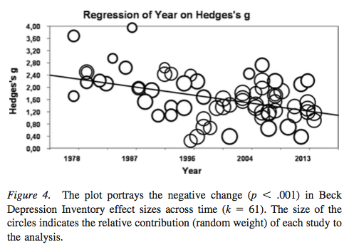
& more concerns with depression

