Slide 1
general orientation
damaging effects of ‘neuroticism’ (volatility & withdrawal) on wellbeing
compassion & goodwill for others & for ourselves
mindbus/bus driver metaphor as a reminder about several coping skills

Slide 2
course outline/our journey
values, self-determination
mindset, exercise & sleep
willpower, diet, dependencies
mindbus & coping responses
savouring & gratitude
work, expertise, strengths
dunbar, roles, needs, dyads
nourishing, conflict, wisdom
groups, weak ties, resonance
review & stepping forward

Slide 3
exercise
four foundational lifestyle practices
managing these 4 foundational practices well gives us so much more vitality and wellbeing … as well as longer healthier lives
good self-control helps us manage these 4 practices well … and managing them well feeds back to build our self-control
diet
dependencies include sugar alcohol and smoking as well as legal & illegal drugs
depend-encies
sleep

Slide 4
mediterranean diet & mental health
Lai, J. S., et al. (2014). "A systematic review & meta-analysis of dietary patterns and depression in community-dwelling adults." Am J Clin Nutr 99(1): 181-197.
Slyepchenko, A., et al. (2017). "Gut microbiota, bacterial translocation, & inter-actions with diet: pathophysiological links between major depressive disorder & non-communicable medical comorbidities." Psychother Psychosom 86(1): 31-46.
Parker, G. B., et al. (2017). "Vitamin D & depression." J Affect Disord 208: 56-61.
Esteban-Cornejo, I., et al. (2016). "Adherence to the Mediterranean diet and academic performance in youth." Eur J Nutr 55(3): 1133-1140.
Opie, R. S., et al. (2017). "Dietary recommendations for the prevention of depression." Nutr Neurosci 20(3): 161-171.
Yary, T., et al. (2016). "Dietary magnesium intake & the incidence of depression: A 20-year follow-up study." Journal of Affective Disorders 193: 94-98.
Martinez-Gonzalez, M. A. and A. Sanchez-Villegas (2016). "Food patterns and the prevention of depression." Proc Nutr Soc 75(2): 139-146.
Hayward, J., et al. (2016). "Lifestyle factors and adolescent depressive symptomatology: Associations and effect sizes of diet, physical activity and sedentary behaviour." Aust N Z J Psychiatry 50(11): 1064-1073.
Dash, S. R., et al. (2016). "Diet and common mental disorders: the imperative to translate evidence into action." Frontiers in Public Health 4: 81.
Chang, S.-C., et al. (2016). "Dietary flavonoid intake and risk of incident depression in midlife and older women." Am J Clin Nutr 104(3): 704-714.

Slide 5
drugs ordered by overall harm scores
Nutt, D. J., et al. (2010). "Drug harms in the UK: a multicriteria decision analysis." Lancet 376(9752): 1558-1565.

Slide 6
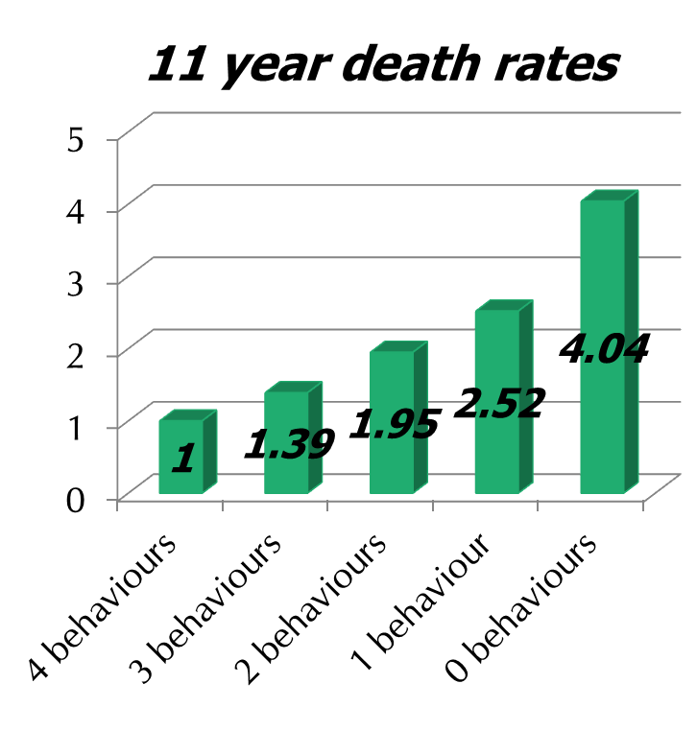
do you want to be 14 yrs younger?
20,224 UK adults
aged 45 to 79
no initial cancer/CHD
health behaviours rated
not smoking
physically active
at least 5 fruit & veg daily
1-14 alcohol units weekly
Khaw K-T, et al. “Combined impact of health behaviours …” PLoS Med 2008;5(1):e12

Slide 7
willpower
can do, want to, will do
mindset
autonomous not controlled
growth not fixed
motivation
strong not weak

Slide 8
balance cool ‘know’ & hot ‘go’ systems
cool cognitive ‘know’ system:
cognitive, slow, strategic, emotionally neutral, flexible, integrated, coherent,
seat of self-control & self-regulation
hot emotional ‘go’ system:
basis of emotionality, fears as well as passions,
impulsive & reflexive
Metcalfe, J. and W. Mischel (1999). "A hot/cool-system analysis of delay of gratification: dynamics of willpower." Psychological review 106(1): 3-19.

Slide 9
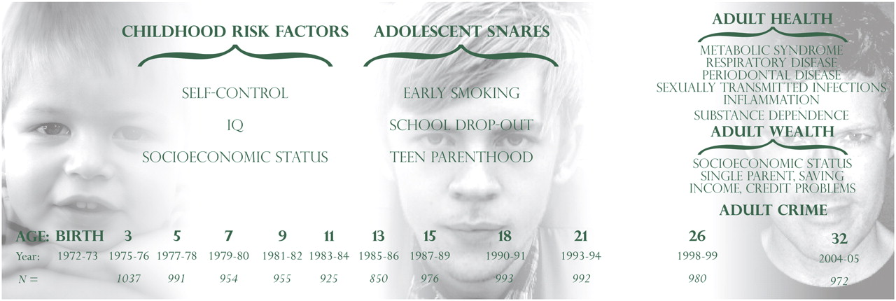
design of the dunedin multidisciplinary
health and development study
Moffitt T E et al. PNAS 2011;108:2693-2698
©2011 by National Academy of Sciences
Notes:
Design of the Dunedin Multidisciplinary Health and Development Study.

Slide 10
willpower
getting it done
wooping:
mental contrasting & implementation intentions
deliberate practice:
repeated, stretching feedback-informed
building block work
goals

Slide 11
Gabriele Oettingen’s technique of ‘WOOPing’ – Wish, Outcome, Obstacle, Plan – builds on the many research studies showing the value of both ‘Mental Contrasting’ and ‘Imple-mentation Intentions’ for achieving challenging goals

Slide 12
general orientation
damaging effects of ‘neuroticism’ (volatility & withdrawal) on wellbeing
compassion & goodwill for others & for ourselves
mindbus/bus driver metaphor as a reminder about several coping skills

Slide 13
the damaging effects of neuroticism

Slide 14
the importance of personality

Slide 15
assessing personality

Slide 16
it’s entirely possible to change

Slide 17
general orientation
damaging effects of ‘neuroticism’ (volatility & withdrawal) on wellbeing
compassion & goodwill for others & for ourselves
mindbus/bus driver metaphor as a reminder about several coping skills

Slide 18
compassion for others & ourselves
If you want others to be happy, practice compassion.
If you want to be happy, practice compassion.
Dalai Lama
early family environment
school teachers & other kids
work place
couple relationships
friendship & other supports
therapeutic relationships
Notes:
Carlson et al - 3573
29 studies involving 1206 patients reviewed. results were encouraging and tended to increase between end of treatment and follow-up assessments about 3 months later. more sessions (about 12 sessions over 12 weeks) and the use of tapes are beneficial. individual a bit better than group if similar time. psychological and physical symptoms respond approximately equally well.

Slide 19
huge amounts of evidence
seeing more clearly – so much scientific research supports this understanding; this slide focuses on some of the ways early life experience affects us
Bond L, Carlin JB, Thomas L, et al. Does bullying cause emotional problems? A prospective study of young teenagers. BMJ 2001; 323: 480-4.
Brewin CR, Firth-Cozens J, Furnham A, et al. Self-criticism in adulthood and recalled childhood experience. J Abnorm Psychol 1992; 101: 561-6.
Besser A, et al. The apple does not fall far from the tree: attachment styles & personality vul-nerabilities to depression in 3 generations of women. Pers Soc Psychol Bull 2005;31:1052-73.
Irons C, Gilbert P. Evolved mechanisms in adolescent anxiety and depression symptoms: the role of the attachment and social rank systems. J Adolesc 2005; 28: 325-41.
Teicher MH, Samson JA, Polcari A, et al. Sticks, stones, and hurtful words: relative effects of various forms of childhood maltreatment. Am J Psych 2006; 163: 993-1000.
Johnson JG, Cohen P, Chen H, et al. Parenting behaviors associated with risk for offspring personality disorder during adulthood. Arch Gen Psychiatry 2006; 63: 579-87.
Reti IM, Samuels JF, Eaton WW, et al. Influences of parenting on normal personality traits. Psychiatry Res 2002; 111: 55-64.
Notes:
Carlson et al - 3573
29 studies involving 1206 patients reviewed. results were encouraging and tended to increase between end of treatment and follow-up assessments about 3 months later. more sessions (about 12 sessions over 12 weeks) and the use of tapes are beneficial. individual a bit better than group if similar time. psychological and physical symptoms respond approximately equally well.

Slide 20
compassion for self & others

Slide 21
general orientation
damaging effects of ‘neuroticism’ (volatility & withdrawal) on wellbeing
compassion & goodwill for others & for ourselves
mindbus/bus driver metaphor as a reminder about several coping skills

Slide 22
mindbus/bus driver metaphor
driver: challenge is to drive with spine & heart to role goals that nourish autonomy, competence, relatedness & beneficence.
passengers: mindfully noting/labelling (naming is taming) - catastrophizing, ruminating/worrying & self-blame/criticism.
conductor/kind hat: using our own name & soothing touch (explore), then relaxing, releasing, encouraging & recharging.
conductor/wise hat: reappraisal, stepping back, perspective ‘as if’ happening to someone else, what learned or improved?
coffee stop: various forms of therapeutic writing, talking, and emotional processing.
a reminder framework for 5+ important coping skills

Slide 23
passengers – identify, label, tolerate

Slide 24
conductor – wise hat

Slide 25
general orientation
damaging effects of ‘neuroticism’ (volatility & withdrawal) on wellbeing
compassion & goodwill for others & for ourselves
mindbus/bus driver metaphor as a reminder about several coping skills

